Slide 1
Biol 7200: Programming for Bioinformatics version control with git

Slide 2
Plan for today
Tricky regex solution from Tuesday
Demos
Git

Slide 3
Plan for today
Tricky regex solution from Tuesday
Demos
Git

Slide 4
The regex that stumped me
$ echo "___123___123___" | grep -Eo ".*[0-9]+"
___123___123
$ echo "___123___123___" | grep -Eo ".*[0-9]+?"
___123___123___
The issue:
“?” makes quantifiers lazy in PCRE
They have no documented function (that I can find) in GNU ERE to modify preceding quantifiers

Slide 5
An illustration of what’s happening
$ echo "aabbcc" | grep -Eo "[ac]{2}b{2}"
aabb
$ echo "aabbcc" | grep -Eo "[ac]{2}b{2}?"
aabb
cc
What’s happening:
“?” makes the preceding element (character and quantifier) optional
“?” is a quantifier 0 or 1. It seems to apply that in this context too

Slide 6
Plan for today
Tricky regex solution from Tuesday
Demos
Git

Slide 7
Plan for today
Tricky regex solution from Tuesday
Demos
Git

Slide 8
What is git?
https://git-scm.com/book/en/v2

Slide 9
Git is a version control system
Tracks changes to files inside a directory (A.K.A. repository)
Records a history of changes (commits) along with optional messages
Allows branches in the same repo with divergent “histories”
Allows rewinding to earlier states and fast-forwarding back to later states
Allows multiple users to work on the same repo and then “merge” changes

Slide 10
Git is a way of life
We’re going to cover what git is and does
Learning git isn’t just remembering the commands. It’s adopting a workflow that uses version control
You will learn by doing – getting into the habit
Take the opportunity to use git when developing scripts for assignments

Slide 11
Some key commands (syntax: git <command>)
init
status
diff
add
commit
log
branch
merge
checkout
revert

Slide 12
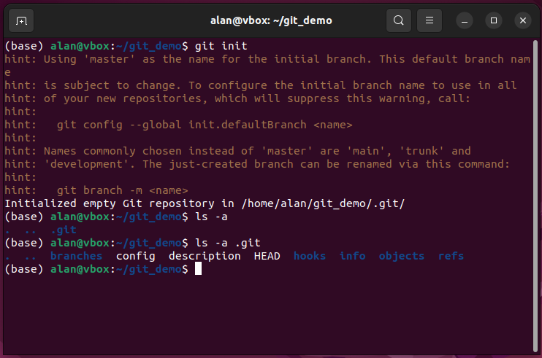

Initialize a repo with git init

Slide 13
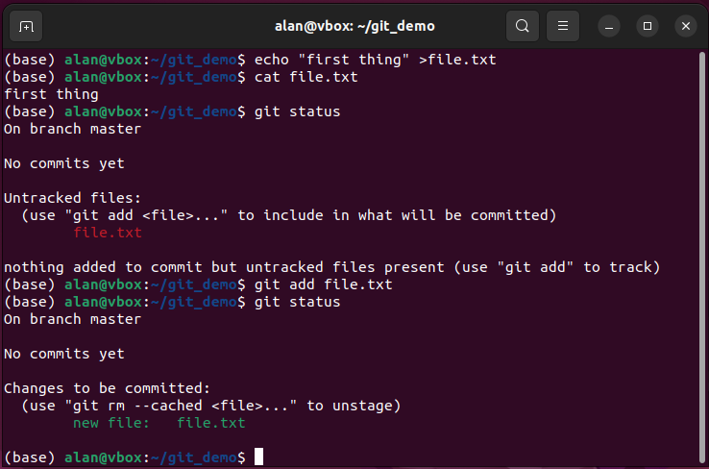
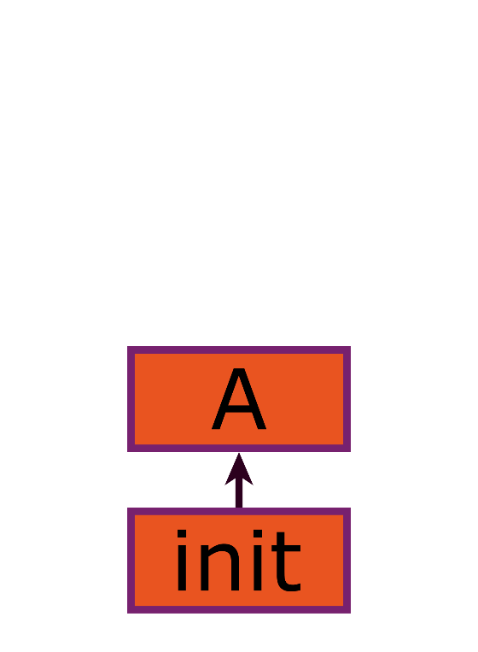
Choose files to add and commit a snapshot

Slide 14
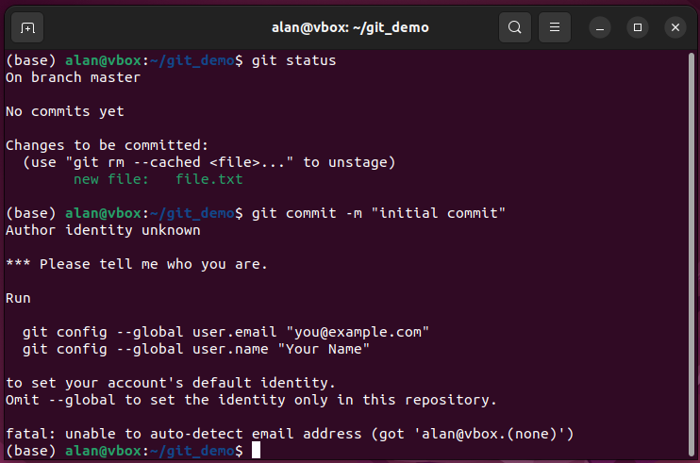
Git keeps track of who does what

Slide 15
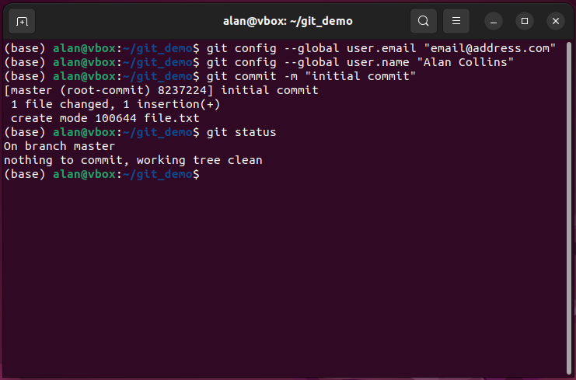
Commit changes to take a snapshot of staged things

Slide 16
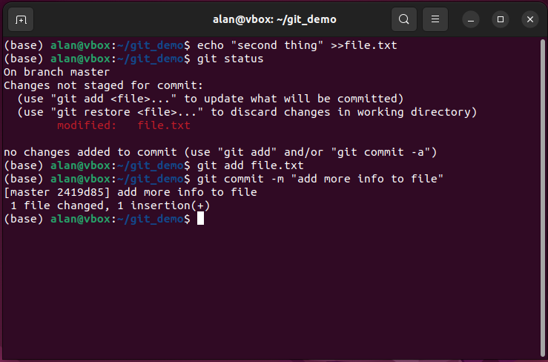
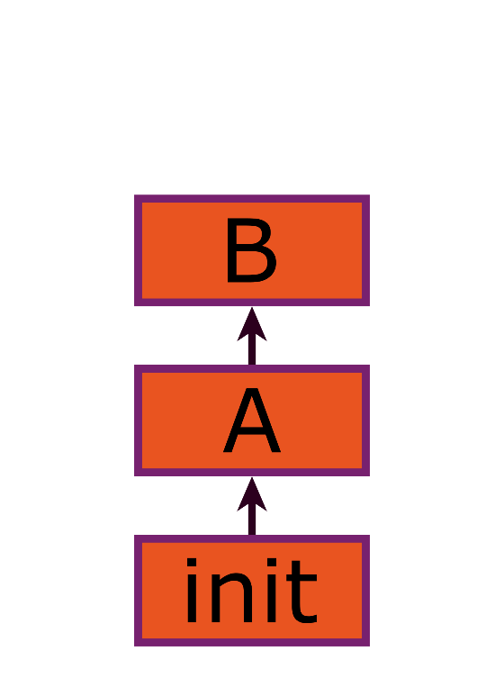
Track history of changes

Slide 17
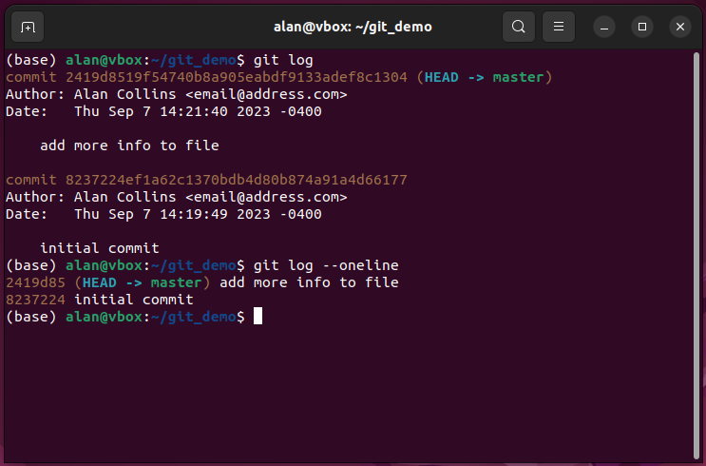
review history of changes

Slide 18
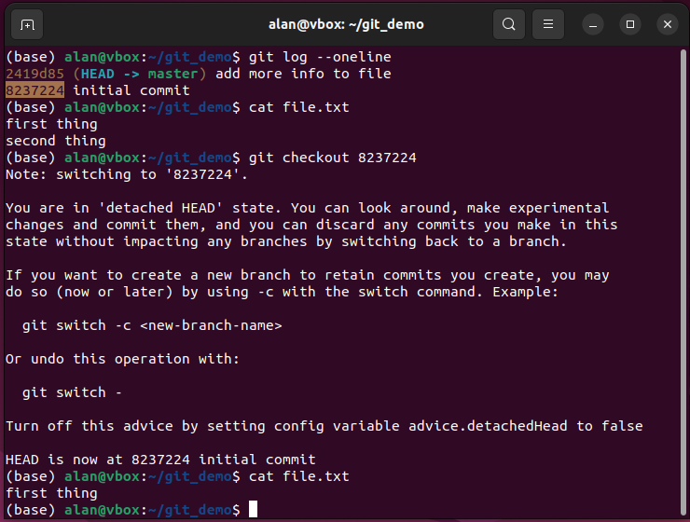
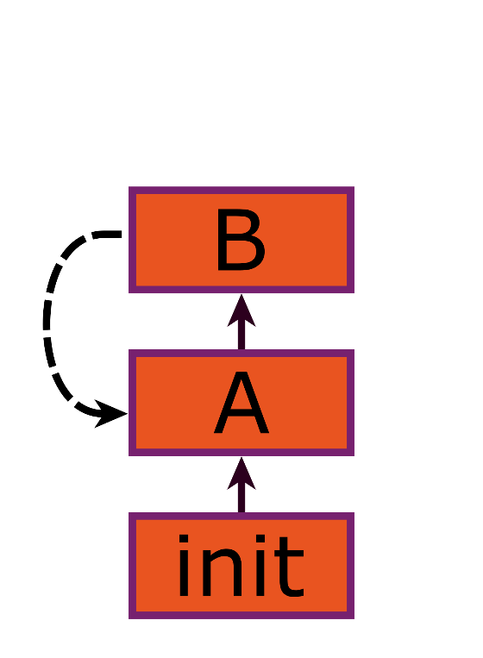
checkout previous versions to Look back in time

Slide 19
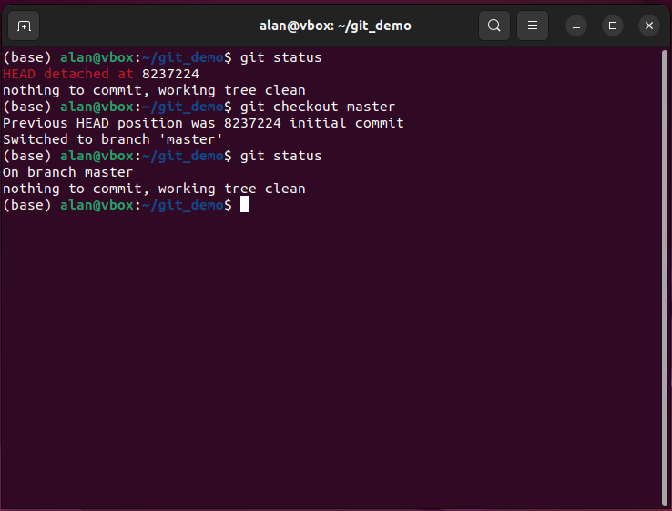
Return by checking out the branch name

Slide 20
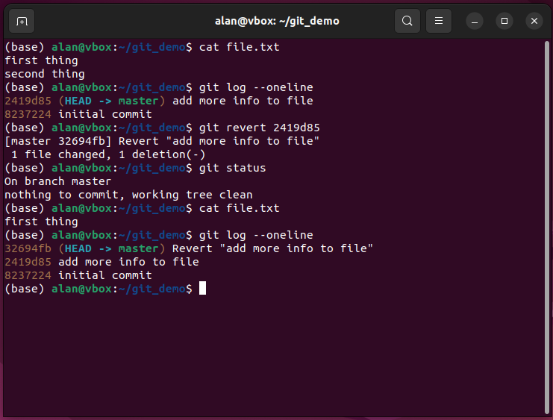
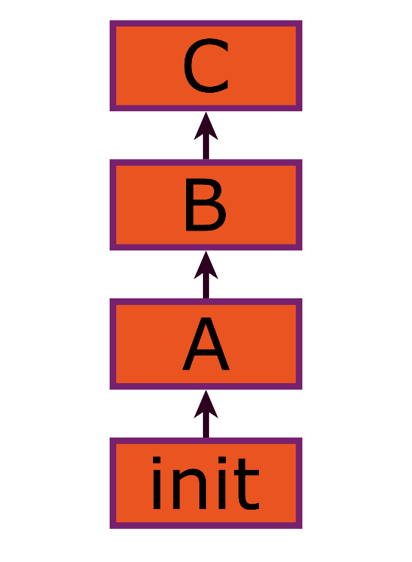
Revert to previous version to undo commits

Slide 21
Git is a crucial skill for programming
Check some job postings – many state git as a required skill
Not just knowing the commands
Knowing the workflow
Knowing how to write good commit messages
Use exercises to practice the individual workflow

Slide 22
Good commit messages
Commit messages are notes to your future self or coworkers
They are used to identify which commits are relevant to a topic
Often used to identify when a bug was introduced or fixed
Can be used to pick a point in time to go back to
Can document changes for use in a changelog
More, smaller commits are better
You can undo 1000 commits
You can’t undo 0.5

Slide 23
Some commit message dos and don’ts
Don’t:
Use generic commit messages (“changes”, “edits”, “foo”)
Use overly long commit message headers (“modified the way that the x method interacts with…”)
State changes made (“changed grep –Po ‘([a-z]+)’ to grep –Po ‘([a-zA-Z]+)’”)
Omit important information about changes
Do:
Use a commit body if more details are needed (git commit –m “headline” –m “longer body”)
Indicate what the commit did (“docs: add –r option help message”, “refactor: rework file reading function”)
Explain why the commit is needed in body (-m “bugfix: issue 123” –m “code was stuck in while loop when email was empty string. Now require user to add email”)
Use headers that finish the sentence “Applying this commit will …”
Name issue numbers if you are fixing a tracked issue

Slide 24
Looking for inspiration?
An example of strict commit message formatting guidelines
https://github.com/angular/angular/blob/main/CONTRIBUTING.md#-commit-message-format
An example of silly commit message formatting
https://gitmoji.dev/

Slide 25
Branches are a way to experiment with your code
They create a new history separate from your master branch
Can be discarded, merged into master, or kept around
Useful to work on a feature/fix while leaving your master branch in a working state

Slide 26
Demo if there’s time

Slide 27
End of Lesson

